Slide 1

Shortest Paths An Introduction to Traversals
CSCI 39575 Graph Theory
By Ariel Avshalom

Slide 2

How do you…
Get to university or work
Get out of bed
Get your early morning bacon?

Slide 3
It starts with making decisions
But how do you make those decisions?
Where do your planning skills come from and are they successful?

Slide 4
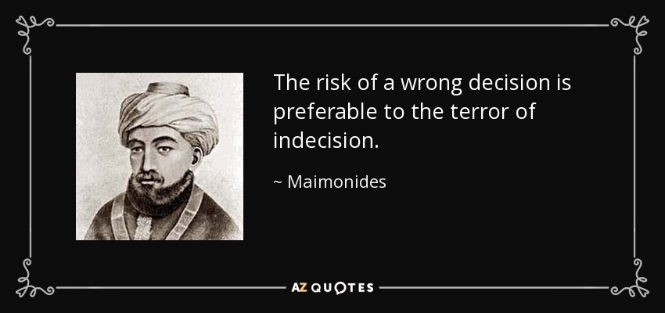


Lots of advice on how to do this

Slide 5

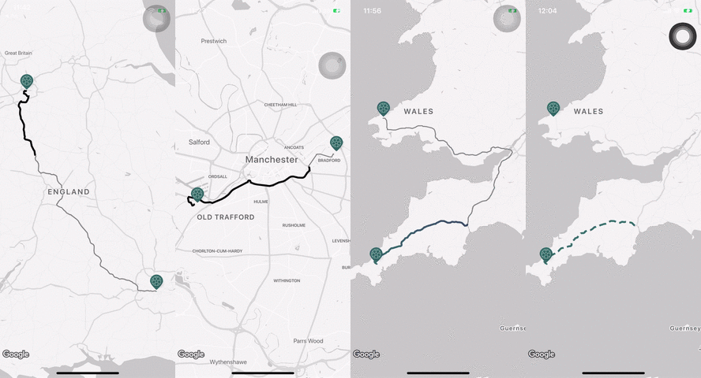
Pathfinding
Humans have very sophisticated methods of deciding how to get somewhere
Many companies and universities are interested in how we do it

Slide 6
AI Pathfinding
One idea is to use AI for pathfinding
What happens here is complex (there are many papers on this topic) and won’t be covered in detail
The main idea is training a variation of decision systems (like neural networks) to optimize for a set of cost equations like
Amount of time spent
Number of errors
Cost of movement
A popular field is multi-agent pathfinding which involves finding a path in a situation with multiple moving agents

Slide 7


Hunter’s CS faculty study this!
At Hunter, we have Professor Susan Epstein, who has robots she’s training to walk around crowded rooms
We also have Professor Ioannis Stamos who works in 3D imaging (he’s also got a robot)

Slide 8
Narrowing our focus
Most practical systems such as
Video games
Delivery services
Humans (sometimes…)
Use some form of algorithm to find a good path in a system
Oftentimes, the cost of finding a good path varies on the system in question and choosing the right algorithm is very important
For instance…

Slide 9
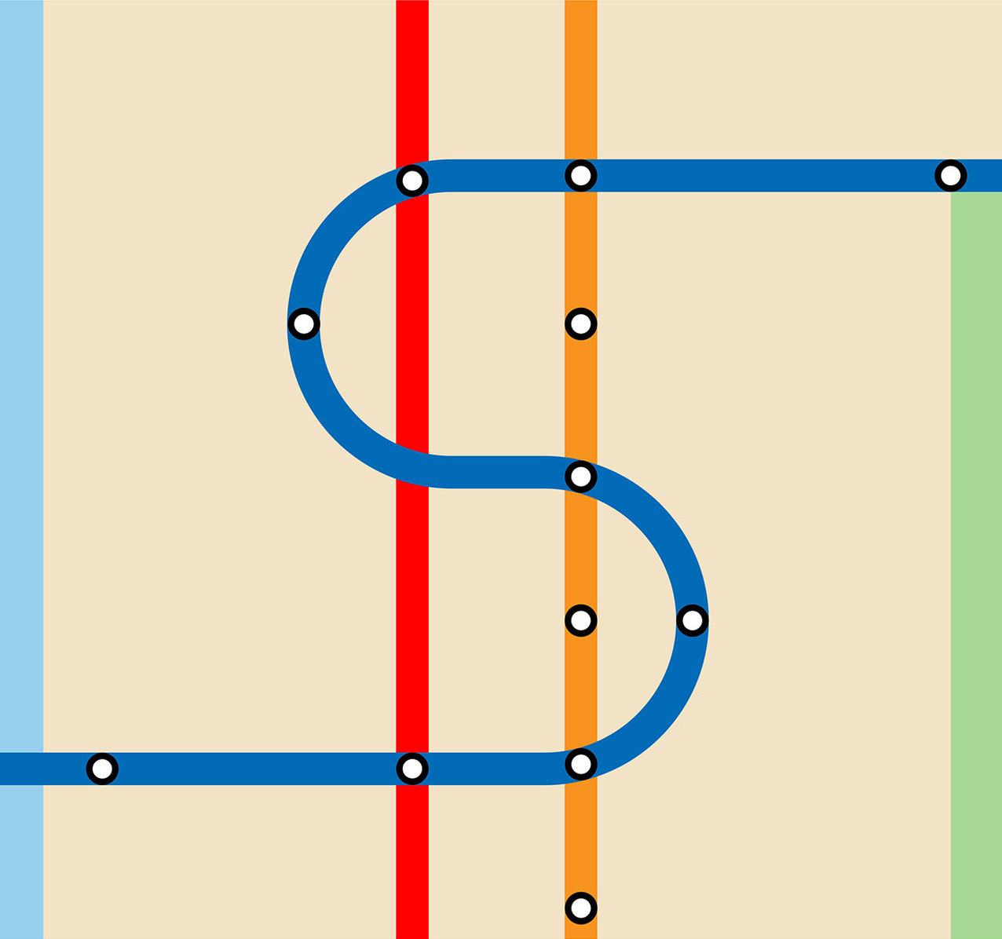
Subway nightmare
You wake up late (because humans are terrible at making decisions) and you need to get to Hunter
Typically, you commute via the F then the 6 train
When you transfer on to the 6, you hear that there is a massive delay and you will be late if you stick to your normal plan
What should you do?
This is just one case where you need to be able to pivot into multiple different solutions
And guess what…this happens on a huge scale at nearly every moment of every day

Slide 10
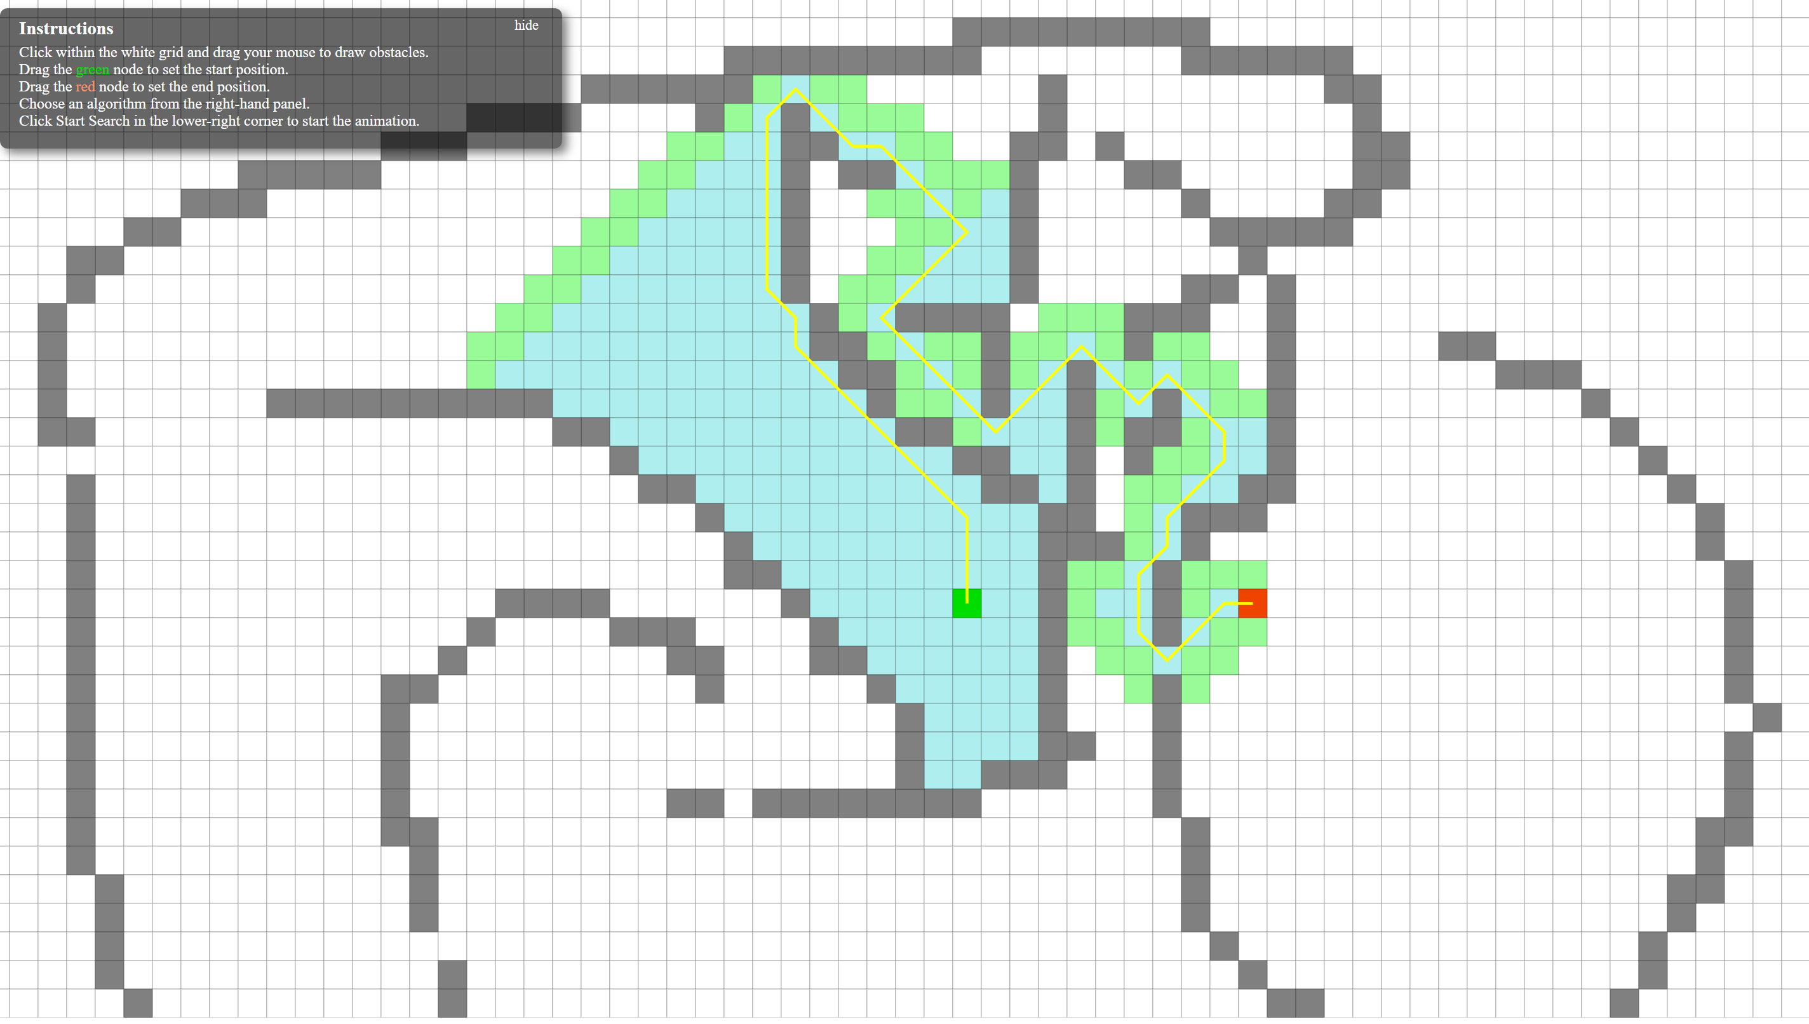
Useful demonstration of pathfinding

Slide 11


Pathfinding algorithms
Some algorithms we’ll explore in this unit include
DFS and BFS
Dijkstra’s Algorithm
A*
Heuristic search
We’ll also take a quick look at flow networks

Slide 12
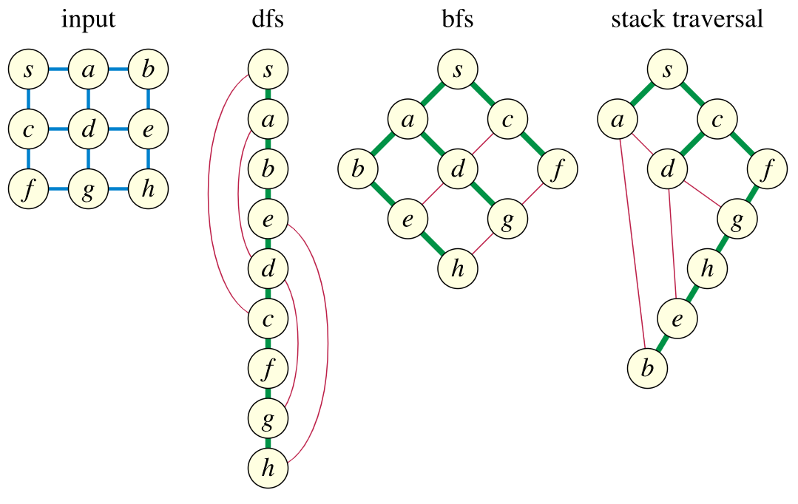
Graph traversals
Let’s say you want to find a traversal path that
Visits all the nodes of the graph
Traverses all the edges of the graph
Note that nodes and edges can be visited more than once
The input is a simple, undirected and connected graph
How do you do it? There are many algorithms…

Slide 13

General scheme
Pick a starting node and travel to another node it is connected to (since our graph is connected)
Using traversed edges go to one of the visited nodes that has an incident untraversed edge
Traverse the untraversed edge
Continue until all the edges are traversed
Like before, there are so many ways of doing this…

Slide 14
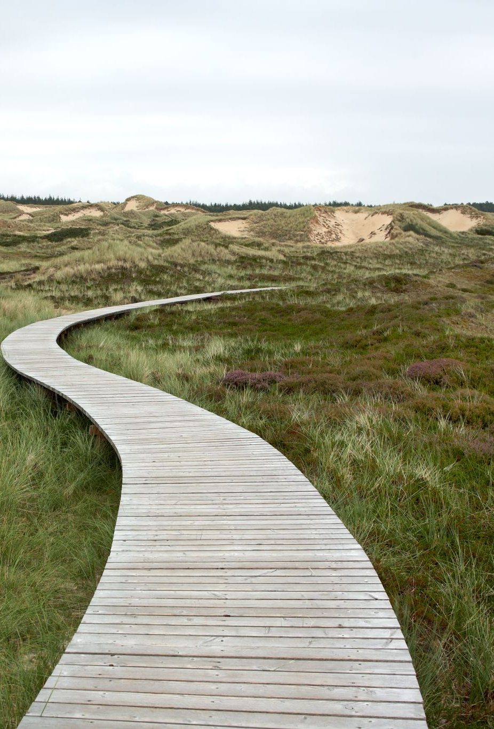
Objectives
In order to be efficient
The rules to find an untraversed edge should be simple
The data structure used should be efficient
The algorithm should take O(m) time
This is because edges tend to occur more than nodes
Example: A Euler path is the shortest possible traversal path since…
No edge is traversed more than once

Slide 15
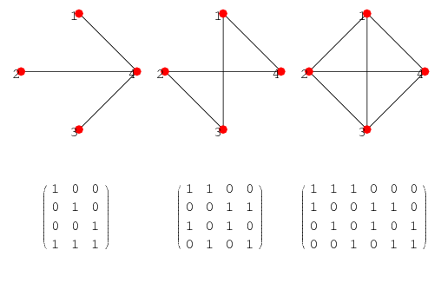
Representing graphs
There are two ways that are generally used to represent graphs:
Note: n are the nodes and m are the edges
An adjacency matrix Θ(n^2)
An adjacency list Θ(n+m)
There is also a representation called an incident matrix Θ(n*m) (nodes from top to bottom, edges from left to right):

Slide 16
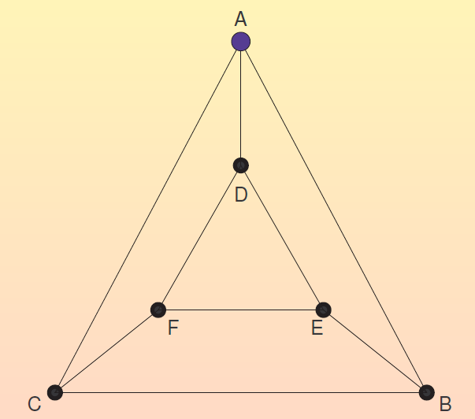
Example traversal using this graph:
Notes:
Final Traversal:
ABEDFEBCADFC

Slide 17
Traversal trees
Tree structure (rooted, ordered and directed):
The root is the first visited node of the tree
Node u is the parent of v if the first visit to v happened after traversing the edge (u,v)
The children of u are ordered according to the time they were first visited from u
Edge classification:
Tree edge: an edge from a vertex to one of its children
Back edge: an edge from a vertex to one of its ancestors
Forward edge: an edge from a vertex to one of its descendants which is not its child
Cross edge: an edge from a vertex to another vertex that is neither one of its ancestors nor one of its descendants in the traversal tree
Let’s do an example on OneNote

Slide 18
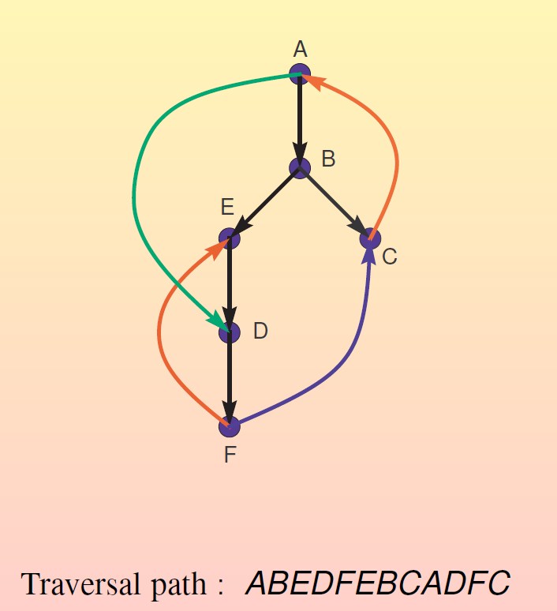
Traversal Example:

Slide 19

Depth first search (DFS)
This is a part of a question you might see during an interview!
Here is the main idea:
Visit a vertex then recursively visit all its neighbors in order
Output: A traversal forest that contains a traversal tree for each connected component of the graph
In a traversal forest, each tree is a directed tree
Recall that a forest is a bunch of connected trees
Check out this video for implementing a DFS, you can already see that a stack is necessary

Slide 20
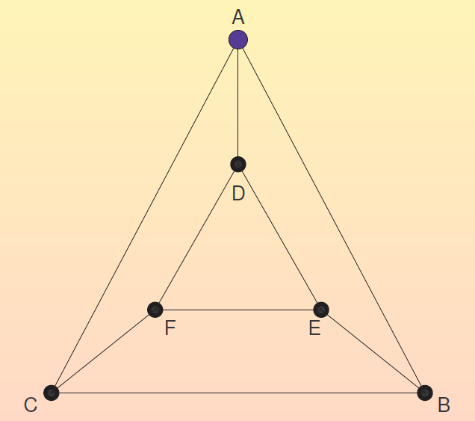
One more time!
Notes:
Path: ABCACFDADEBEF - EDFCBA

Slide 21
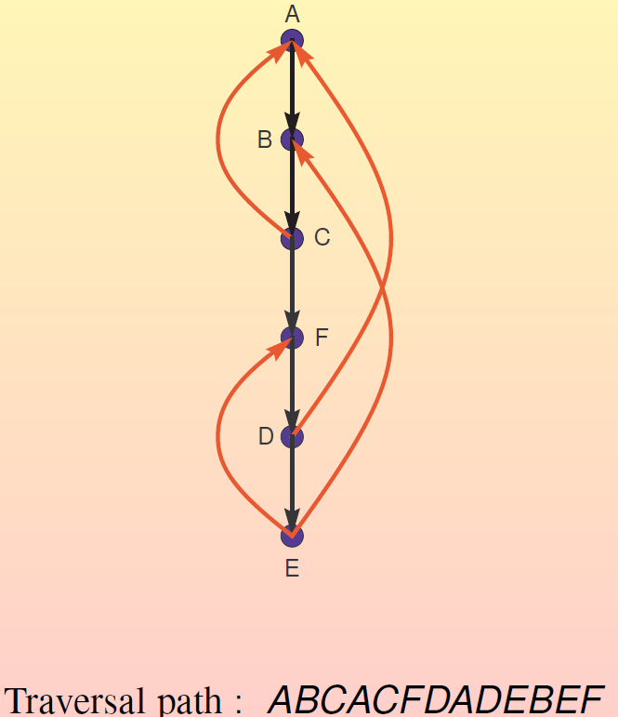
Here is how the final tree might look:
Notes:
ABCACFDADEBEF

Slide 22
How do we know that DFS is a correct traversal?
We know from before that DFS visits all the nodes
We also know that DFS traverses all the edges
This is because the DFS algorithm recursively goes through each of the neighboring nodes of a node

Slide 23

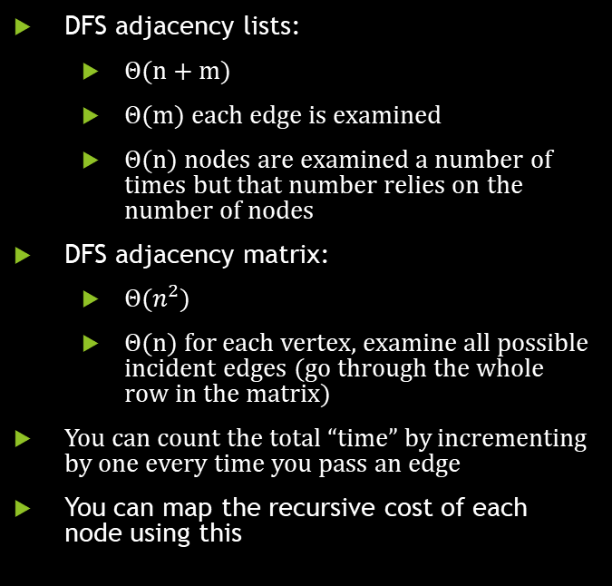
Algorithmic complexity
DFS adjacency lists:
Θ(n + m)
Θ(m) each edge is examined
Θ(n) nodes are examined a number of times but that number relies on the number of nodes
DFS adjacency matrix:
Θ$(n^{2})$
Θ(n) for each vertex, examine all possible incident edges (go through the whole row in the matrix)
You can count the total “time” by incrementing by one every time you pass an edge
You can map the recursive cost of each node using this

Slide 24
Is a DFS traversal a Directed Acyclic Graph (DAG)
A directed graph is a DAG if it is directed and has no cycles
Note that this also means you can’t create a Eulerian Path
So is a DFA a DAG?
Think about it a while on your own…
Check out this video of a topological sort of a DAG
Topological sort: a linear ordering of its vertices such that vertex u appears before vertex v for any directed edge (u -> v)

